Slide 1

PREMOLARS
RUNGTA COLLEGE OF DENTAL SCIENCES & RESEARCH
DEPARTMENT OF ORAL PATHOLOGY

Slide 2
Specific learning Objectives
Core areas* | Domain ** | Category #
Introduction | COGNITIVE | MUST KNOW
Tooth numbering/notation Functions Chronology Dimensions Aspects ( 5 - labial, palatal, mesial, distal, incisal ) | COGNITIVE COGNITIVE COGNITIVE COGNITIVE COGNITIVE COGNITIVE | MUST KNOW MUST KNOW MUST KNOW MUST KNOW MUST KNOW

Slide 3
Contents
Introduction
Tooth numbering/notation (All 3 systems)
Functions
Chronology
Dimensions
Aspects ( 5 - labial, palatal, mesial, distal, incisal )

Slide 4
Maxillary 1st Premolars
The maxillary 1st premolar has two cusps , a buccal and a lingual each being sharply defined .The buccal cusp is usually abot 1mm longer than the lingual cusp.The crown is angular ,and the buccal line angles are prominent.
The crown is shorter than that of the canine by 1.5 to 2mm on the average .Although this tooth resembles the canine from the buccal aspect , it differs in that the contact areas mesially and distally are at about at the same level .

Slide 5
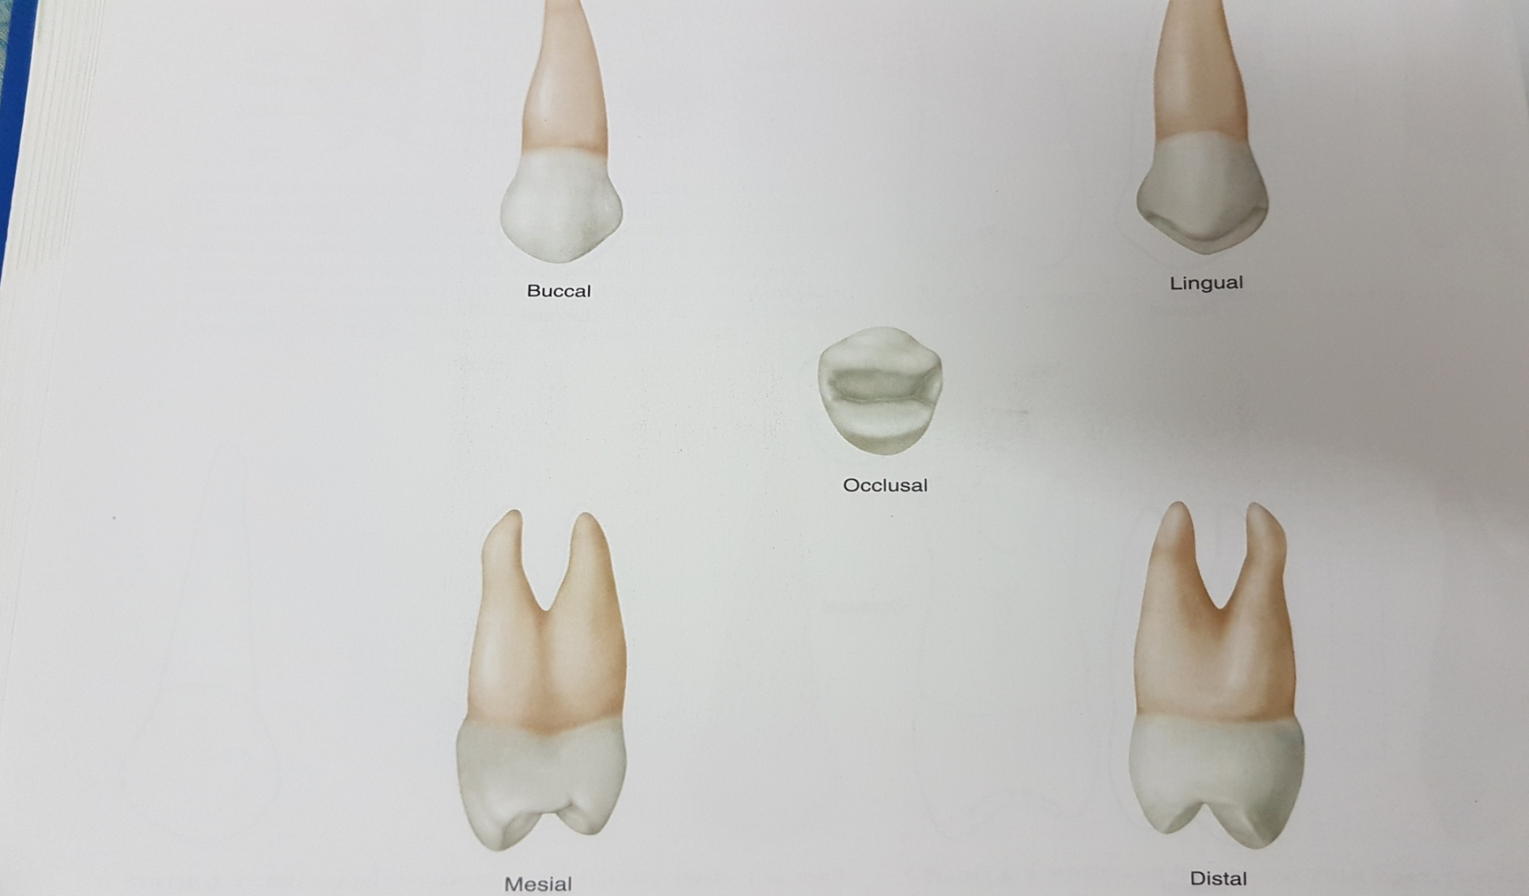
MAX 1ST PREMOLARS
ALL ASPECTS

Slide 6
Various aspects of maxillary 1st premolars
Buccal aspect
From the buccal aspect ,
1.The crown is roughly trapezoidal .The crown exhibits little curvature at the cervical line
buccally is near the centre of the root buccally .
2. The mesial outline of the crown is slightly concave from the cervical line to the mesialcontact area is represented by a relatively broad curvature ,the crest of which lies immediately occlusal to the halfway point from the cervical line to the tip of the buccal cusp .

Slide 7
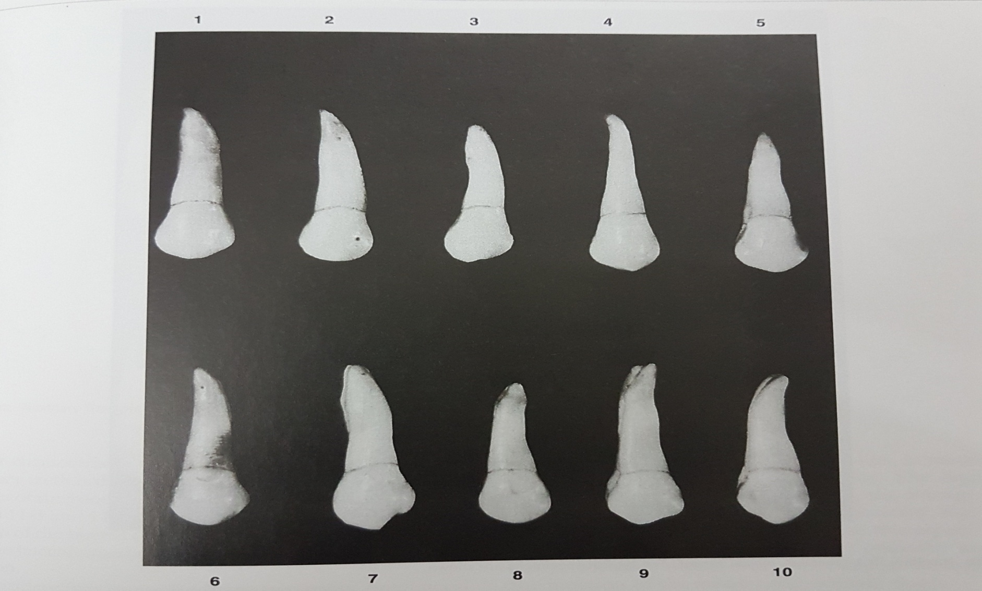
Max 1st premolars
Buccal Aspect

Slide 8
3. The mesial slope of the buccal cusp is rather straight and longer than the distal slope , which is shorter and more curved .
4. The mesial slope of buccal cusp is sometimes notched in other instances , a concave outline is noted at this point .
5. The distal outline of the crown below the cervical line is straighter than that of the mesial , although it may be somewhat concave as well.
6. The width of the crown of the maxillary first premolar mesiodistally is about 2mm less at the cervix than at its width at the point of its greatest mesiodistal measurement .
7. The buccal cusp is long , coming to a pointed tip and resembling the canine in this respect , although contact areas in this tooth are near the same level.

Slide 9
8. The buccal surface of the crown is convex ,showing strong development of the middle buccal lobe .
9. Mesial and distal to the buccal ridge,at or occlusal to the middle third , developmental depressions are usually seen that serve as demarcations between the middle buccal lobe and the mesiobuccal and distobuccal lobes.
10. The roots are 3 or 4 mm shorter than the those of the maxillary canine , although the outline of the buccal portion of the root bears a close resemblance.

Slide 10
Lingual Aspect
From the lingual aspect ,
1. The gross outline of the maxillary first premolar is the reverse of the gross outline from the buccal aspect.
2. The crown tappers toward the lingual because the lingual cusp is narrower mesiodistally than the buccal cusp.
3. The cusp is pointed , with mesial and distal slopes meeting at an angle of about 90 degrees.
4. Naturally , the spheroidal form of the lingual portion of the crown is convex at all points.

Slide 11
5. The mesial and distal outlines of the lingual portion of the crown are convex these outlines are continuous with the mesial and distal slopes of the lingual cusp and straighten out as they join the mesial and distal sides of the lingual root at the cervical line .
6. The cervical line lingually is regular ,with slight curvature toward the root and the crest of curvature centered on the root. Because the lingual portion of the crown is narrower than the buccal portion , it is possible to see part of the mesial and distal surface of crown and root from the lingual aspect depending on the posing of the tooth and the line of vision .

Slide 12
Because the lingual cusp is not as long as the buccal cusp , the tips of both cusps , with their mesial and distal slopes , may be seen from the lingual aspect.
7. The lingual portion of the root , or the lingual portion of the lingual root if two roots are present , is smooth and convex at all points .The apex of the lingual root of a twon root specimen tends to be blunter than the buccal root apex .

Slide 13
Mesial Aspect
The mesial aspect of the crown of the maxillary 1st premolar is also roughly trapezoidal.
2.Most maxillary premolars have two roots ,one buccal and one lingual ,these are clearly outlined from the mesial aspect.The cervical line may be regular in outline `or irregular .In either case the curvature occlusally is less than the cervical curvature on the mesial of any of the anterior teeth.
3.The buccal outline of the crown curves outward below the cervical line.The crest of curvature is often located approx at the junction of cervical and middle thirds , however the crest of curvature may be located within the cervical third .
4.The lingual outline of the crown may be described as a

Slide 14
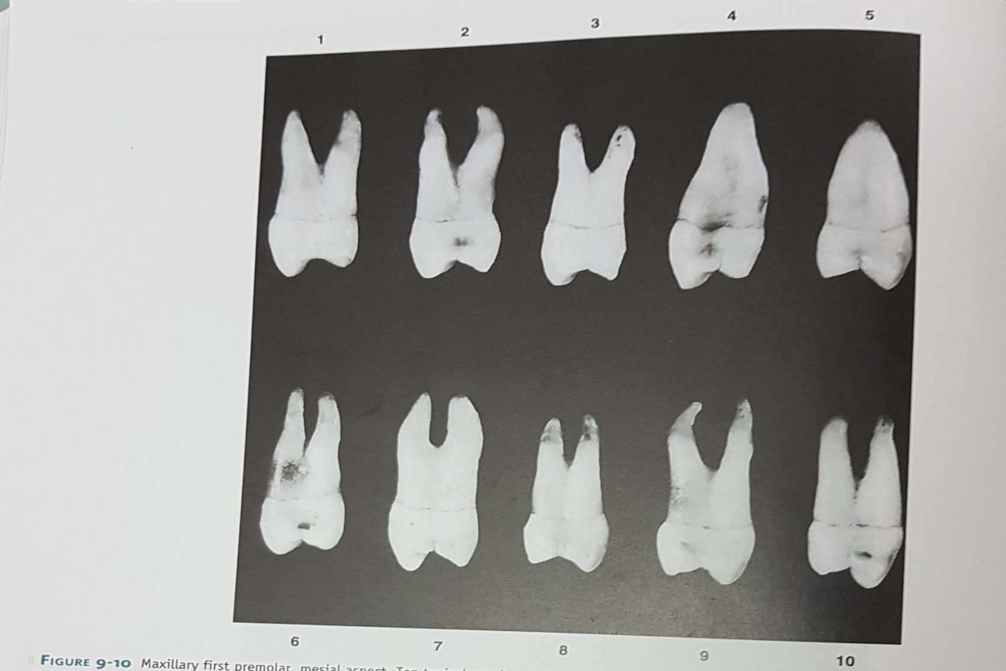
Max 1st premolar mesial aspect

Slide 15
Smoothly curved line starting at the cervical line and ending at the tip of the lingual cusp .
5.The crest of this curvature is most often near the center of the middle third. Some specimen show a more abrupt curvature at the cervical third.
6.The tip of the lingual cusp is on a line ,in most cases with the lingual border of the lingual root. The lingual cusp is always shorter than the buccal cusp , the average difference being about 1mm .
7.From this aspect , it is noted that the cusp of max 1st premolar are blong and sharp with the mesial marginal ridge at about the level of the junction of the middle and occlusal 3rd s.

Slide 16
8.A distinguishing feature of this tooth is found on the mesial surface of the crown.
9.Immediately cervical to the mesial contact area , centered on the mesial surface and bordered buccally and lingually by the mesiobuccal and mesiolingual line angles , is marked depression called the mesial developmental depression .
10.Another distinguishing feature of this tooth is well defined developmental groove in the enamel of the mesial marginal ridge .
11.The buccal outline of the buccal grove , above the cervical line , is straight with a tendency toward a lingual inclination.

Slide 17
12.On those buccal roots having a buccal inclination above the thirds .
13.The lingual root may take a buccal or lingual inclination .
14.The root trunk is long on this tooth , making up about half of the root length.
15.The bifurcation on those teeth with two roots begins at a more occlusal point mesially than distally .

Slide 18
Distal Aspect .
1.The crown surface is convex at all points except for a small , flattened arc just cervical to the contact area and buccal to the center of the distal surface .
2.The curvature of the cervical line is less on the distal than on the mesial surface , often showing a line straight across from buccal to lingual.
3.A deep developmental groove crossing the distal marginal ridge of the crown is not evident .
4.The bifurcation of the roots is abrupt near the apical third , with no developmental groove leading to it such as that found mesially.

Slide 19
Occlusal Aspect
1.The occlusal aspect of the maxillary 1st premolar resembles roughly a six sided hexagonal figure .
2.The six sides are made up of the mesiobuccal which is mesial to the buccal ridge , mesial ridge, mesiolingual which is mesial to lingual ridge , distolingual , distal and distobuccal.
3.The relation and position of various anatomikcal points are to be considered from the occlusal aspect.
4.The crest of the distal contact Area is somewhat buccal to that of mesial contact area , and the crest of the buccal ridge is somewhat distal to that of the lingual ridge.

Slide 20
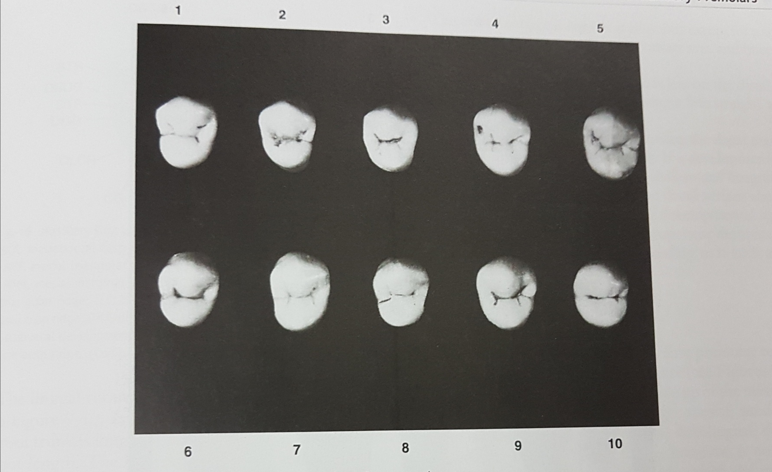
Max 1st premolar occlusal aspect.

Slide 21
Close observation of the crown from this characteristics reveals following:
The distance from the buccal crest to the mesial crest is slightly longer than the distance from the buccal crest to the distal crest.
The distance from the mesial crest to the lingual crest is much shorter than the distance from the distal crest to the lingual crest.
The crown is wider on the buccal than on the lingual.
The buccolingual dimension of the crown is much greater than the mesiodistal dimension.

Slide 22
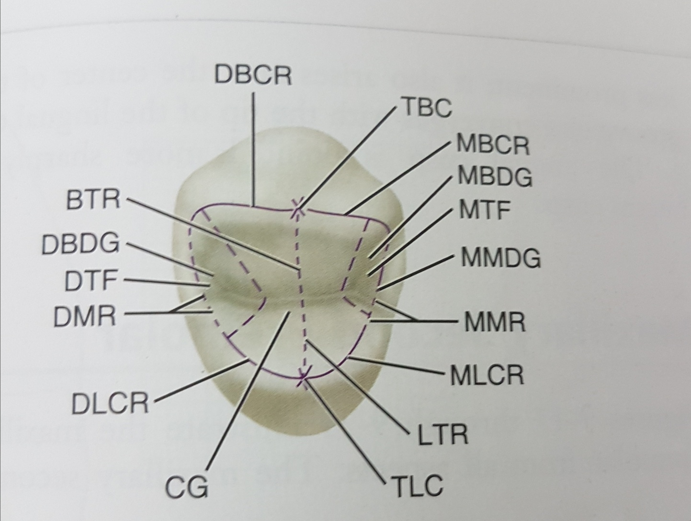

Slide 23
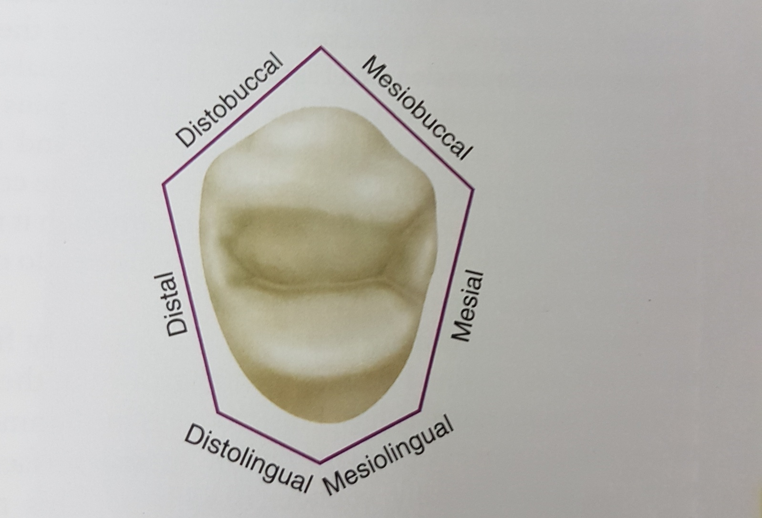

Slide 24
5.The occlusal surface of the maxillary 1st premolar is circumscribed by cusp ridges and marginal ridges .
6.The mesiobuccal cusp and distobuccal cusp ridges are in line with each other and their allignment is in a distobuccal direction
7.In other words even though they are in the same allignment ,the distobuccal cuspridge is buccal to the mesiobuccal cusp ridge.

Slide 25
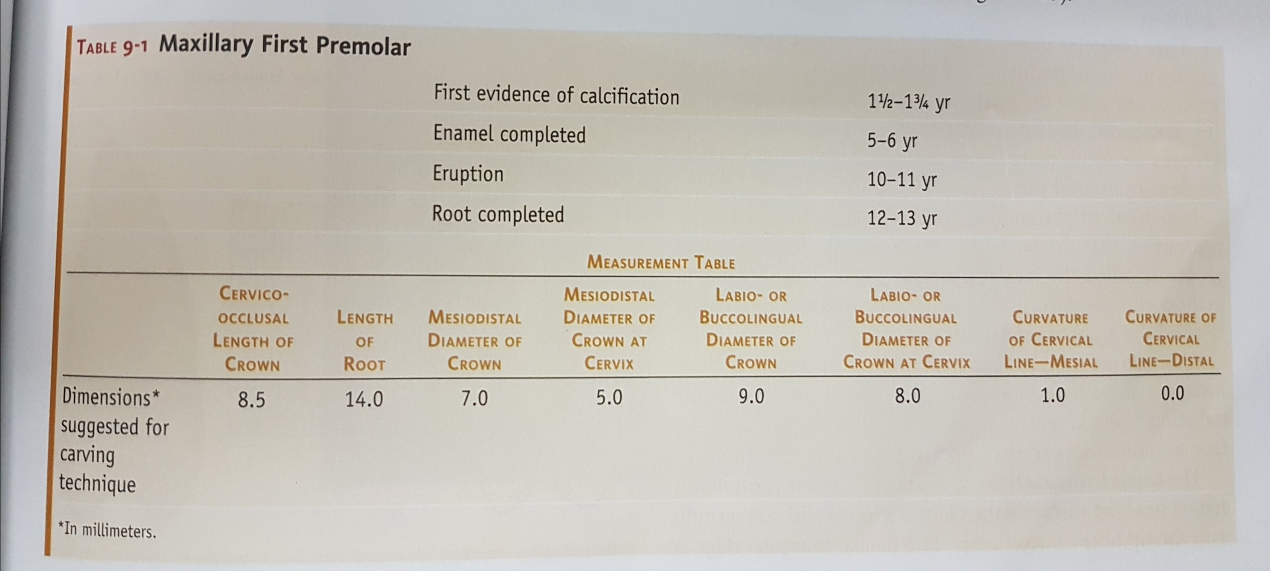
Max1st premolars

Slide 26
SUMMARY
Premolars, also known as bicuspids, are the permanent teeth located between the molars in the back of your mouth and your canine teeth, or cuspids, located in the front. Because premolars are transitional teeth, they display features of both molars and canines and primarily grind and break up food. The food is then vigorously chewed by your molars, making it ready for the digestion process. You have eight premolars total, with four on each side of your mouth.

Slide 27
Take home message
Premolars, also known as bicuspids, are the permanent teeth located between the molars in the back of your mouth and your canine teeth, or cuspids, located in the front

Slide 28
References
Nelson, Stanley J. (2014-11-25). Wheeler's dental anatomy, physiology, and occlusion. ISBN 9780323263238.Philadelphia W.B. Saunders ;2002
Richard Tencate , Oral Histology development ,structure and function . 5th Edition ,1998
Carranza F.A., Michael G. Newman . Clinical periodontology 8,9,10th edition

Slide 29
Frequentely Asked Questions
Describe various aspects of Maxillary/Mandibular premolar in detail
Morphology of Maxillary/Mandibular premolar
Differences beween Labial and Lingual aspect of Maxillary/Mandibular premolar
Draw well labelled diagram of Maxillary/Mandibular premolar

Slide 30
THANKYOU

